Slide 1
Lesson 3:
Three Levels of Government

Slide 2
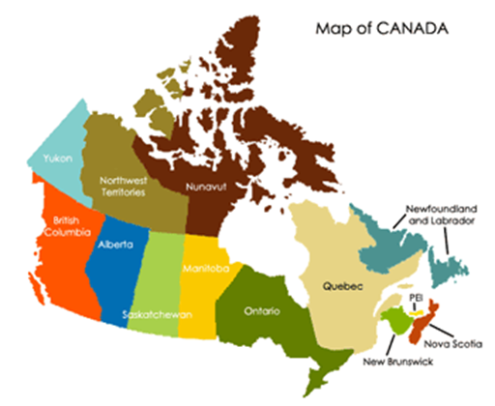
Three Levels of Government
Canada is a very large country with lots of people and different needs and interests.
To support these needs and interests properly, the Canadian government is structured into a three level system: federal, provincial and municipal.
Each government has its own level of elected representatives and appointed officials, as well as a specific matters they are responsible for.

Slide 3
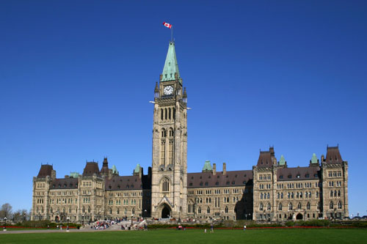
Federal
The elected representative at the federal level is called a Member of Parliament (MP).
There are 308 MPs across Canada.
MPs debate and pass laws in the House of Commons in Ottawa.
The leader of the government is called the prime minister.
The Queen is represented by the governor general.

Slide 4
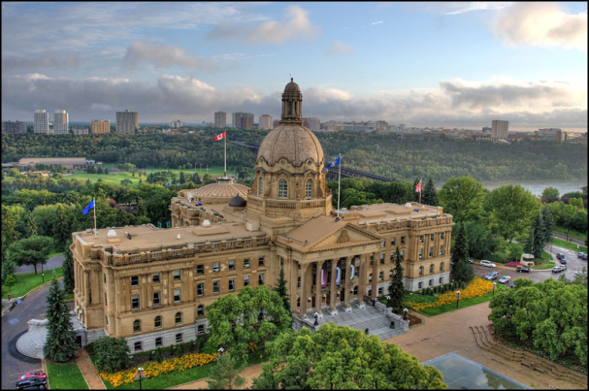
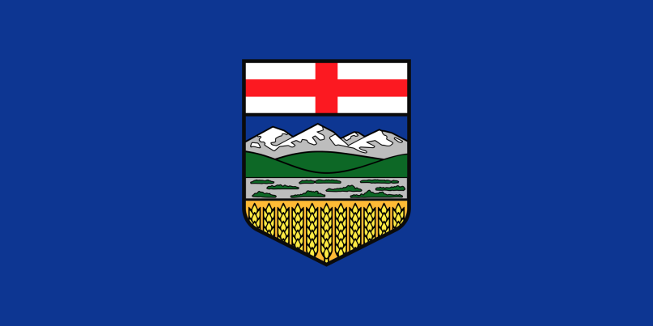
Provincial
The elected representative at the provincial level is called a Member of the Legislative Assembly (MLA).
The legislative body in Alberta has 87 elected MLAs.
MLAs debate and pass laws at the Legislative Assembly in Edmonton.
The leader of the government is called the premier.
The Queen is represented by the lieutenant governor.

Slide 5
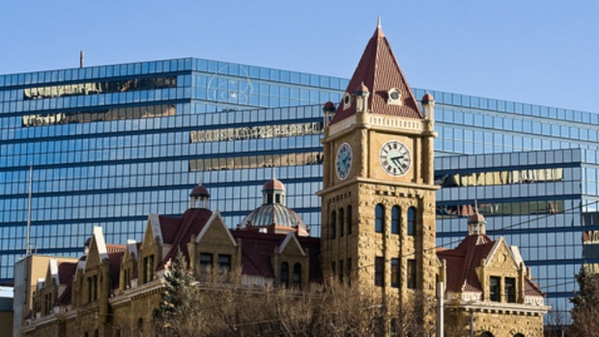
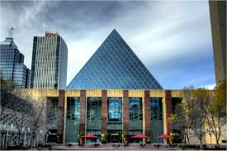
Municipal
The elected representative at the municipal level is called a councillor or alderman.
Municipal councils debate and pass laws at the local or city town hall.
The head of the council is called a mayor or reeve.
The size and structure of the council differs, depending on the population.

Slide 6
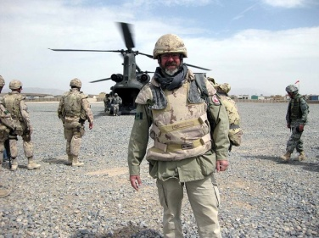
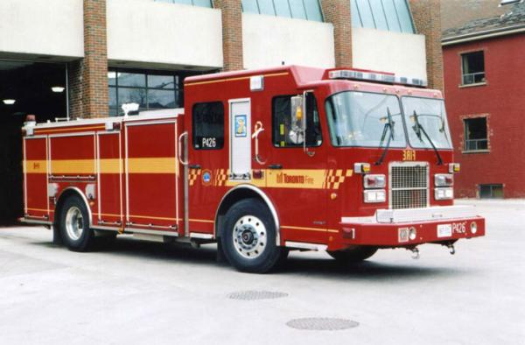
Division of Responsibilities
Federal: Armed forces, international trade and relationships, money, public safety and immigration.
Provincial/Territorial: Health care delivery/hospitals, education, welfare, transportation within the province, justice, energy and the environment.
Municipal: Waste management, water and sewage, community services, local parks and recreation.

Slide 7
Final Thoughts
How does government affect your life?
Which level of government affects your life the most? Why?
Why is it important to know who is your local elected representative?

